Slide 1
Creating inVision Prototype

Slide 2
Prepare your design files
Open your files
Save each Canvas/Artboard
Save As “page-name”.[png, jpg, jpeg]
Ex. if I’m on the Homepage Artboard I would export my Artboard as “homepage.png”
Save your file to > project-name/exports
Ex. my project is Defones so I would save to deftones-site/exports
Make sure to also save your Overlay files too
An overlay file is for example a canvas that represents your Lightbox effect
Upload to inVision

Slide 3
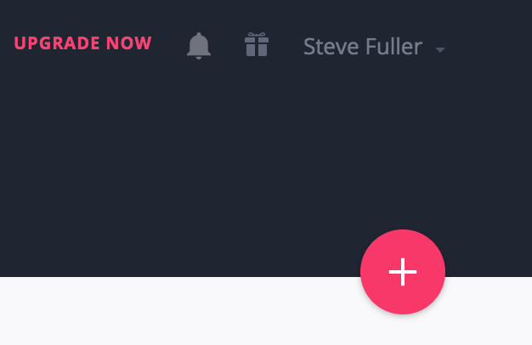
Sign Up for a Free inVision Account
Visit https://invisionapp.com
Sign up / Sign In
Click the big red button with a plus sign
Create New Prototype
Name of Project “Your Band” & Select “Desktop(Web)”
Upload your files
Drag and drop all your files in your Export folder
Optional arrange files
I like to arrange my files by my navigation order
Create prototype

Slide 4
How to create actions
Make sure to review inVisions Help Center for how tos
Main Links
Building Projects
Adding Interactivity
Articles of concern
Creating a Prototype
Upload Screens
Syncing Screens
Adding Interactivity
Prototype Screens
Replacing Screens

Slide 5
Minimum Requirements
All pages must be linked
Demonstrate Lightbox Effect
Demonstrate Filter Effect

